Slide 1
Overview
MicroView FM @ RSC

Slide 2
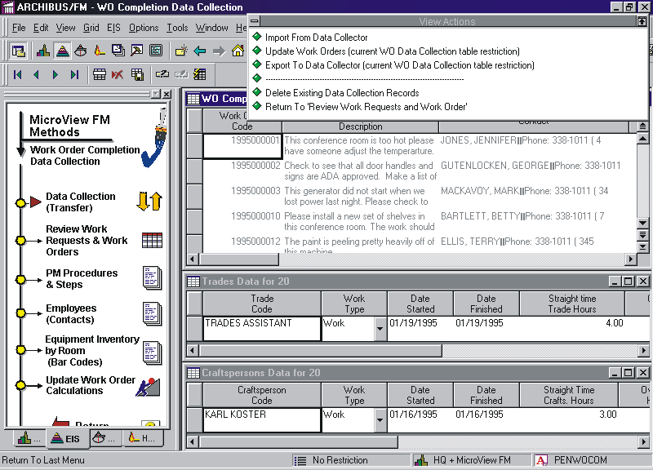
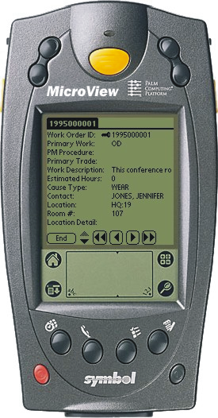
Mobile Data Management
MicroView FM™ is an add-in module for ARCHIBUS/FM that allows facilities data to be collected and verified on a Palm-based data collector.
Features:
Supports ARCHIBUS/FM Versions 10 - 18
Supports Sybase SQL Anywhere, MS SQL Server, and Oracle back-end databases
Supports all Palm™ OS 2.0 or higher devices and Windows Mobile 6
Supports Symbol SPT™ bar code devices
Is sold as software only or as part of a complete kit with a Symbol SPT unit

Slide 3
Mobile Data Management
Why was MicroView FM™ Developed?
Data Collection Issues
Difficult & time consuming to collect mass quantities of accurate Facilities data
Archibus was already designed to handle bar coded items but had no means of easily importing bar coded data
The Solution
In 1999 Symbol released the SPT 1500, a low cost Palm O/S based data collector with a bar code reader.
We wrote the software around the SPT 1500 unit to work with ARCHIBUS. (although our software will work with any Palm O/S device)

Slide 4
Mobile Data Management
Why was MicroView FM™ Developed?
Users told us that a Mobile FM™ product must:
Enforce business data rules - Asset & Space standards must be used as look-up lists on the handheld device to enforce good data collection and uphold set business data rules.
Be easy to use - The software must be easy to use with minimum training.
Ensure data integrity - Data cannot be imported directly from the data collector into the ARCHIBUS asset tables, data must be groomed or validated first.
The basic principles behind MicroView FM
Can use inexpensive Palm O/S® based data collection units. (e.g. M100/M105)
Data transfered via standard Palm Hotync®. Support for wireless, and Palm modem.
Background data (look-up lists) pre-populated to the data collector with the business rules utilizing lookup lists.
Ability to download existing asset records for on-site verification.
Ability to filter or validate incoming data through a transfer Table.

Slide 5
Mobile Data Management
MicroView FM™ supports the following ARCHIBUS® Modules for data collection and work management tasks
Space Management Room & Employee Data
Module Collection Forms
Furniture & Equipment Equipment, Tagged &
Module Non-tagged Furniture
Data Collection and Asset
Receiving Forms
Building Operations Work Order Creation and
Module Completion Data Forms

Slide 6





Mobile Data Management - Sample Process
A work request is phoned, emailed, or typed into a form on the internet.
The work orders to be processed are sent to the Transfer Table. They are then assigned to selected tradespeople.
Step 1
Step 3
Step 4
Step 2
Work order details are downloaded to the selected trades person’s Palm unit.
The work request is added to the queue. The supervisor approves and schedules the work.
S
t
e
p
5
When the work has been done, the requesting person is notified.
At the end of the shift the tradesperson transfers the updated work orders, and any new work requests or work orders created in the field.
The information is checked for validity in the Transfer Table. The ARCHIBUS/FM supervisor may review, repair or reject the records. The records are then processed.
The trades person completes the requested task and updates time & cost details on Palm unit.
Step 8
Step 7
Step 6

Slide 7
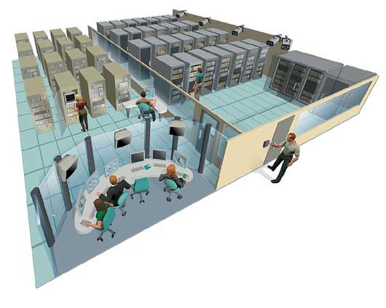
Mobile Data Management
What’s next for MicroView FM?
MicroView FM™ Wireless
MicroView FM™ Remote Client
Utilizes 802.11b Wide-Spectrum Wireless LAN communication standards
internet
Synchronize your MicroView FM data over the internet to the Robert Stephen Consulting, LLC data center

Slide 8
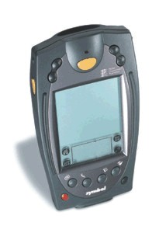

2
CAFM Experts use tools to manage asset inventories & space inventories, and to coordinate & dispatch work orders to MicroView FM Palm units.
Field to Web using
MicroView FM
Remote
Symbol SPT Handhelds w/ MicroView FM Remote Client
Internet
1
Internet
Field personnel use these devices to perform remote field work (data collection, maintenance management).
DATA CENTRE
Internet
3
Web-based tools, such as Web Central are used to view FM data and reports in a user-friendly environment.

