Slide 1
Case Studies Using MicroView
May 2010

Slide 2
Introductions
All MicroView products are fully integrated with ARCHIBUS
Bob Stephen
Managing Director - RSC
Geoff Dryer
Chief Designer – Microview - RSC
Patrick Lynass
Project Manager – Los Angeles - RSC
Karin Ashley
Project Manager – Phoenix –RSC
With the power of ARCHIBUS behind us!

Slide 3
Background / MicroView History Over a Decade of Mobility
iPhone and Android support to be released late 2010
Web Central Version / BlackBerry released
V 3.2 released / automation and patches
RSC purchases exclusive rights to Microview
V 3.1 - Windows Mobile 5
V 3.0 - Support for Pocket PC /
new SyncServer engine /
Multi-language support
June
1999
Oct.
1999
June
2000
Dec.
2000
Feb.
2002
May
2003
June
2004
Dec.
2005
Sept.
2006
Aug.
2009
Oct.
2009
June
2010
2010
V 2.65 - Condition Assessment Activity
V 2.6 - Inspection and Survey forms / Parts Management
V 2.5 - Asset Receiving Module / Palm OS® 4.0
V 2.05 - MSSQL support
V 2.0 - Space Module data collection forms / Oracle support
V 1.3 - Building Operations Module / name change to Microview FM
V 1.1 - Initial release of Palm/FM contains only the F&E module.

Slide 4
Background / MicroView Products
All MicroView products are fully integrated with ARCHIBUS
MICROVIEW FM
A fully integrated PDA/Mobile device software solution, space, assets, maintenance, inspections.
MICROVIEW PARKING MANAGER
Provides complete parking management including
assigned parking stalls, ticketing, and reservations.
MICROVIEW DELIVERY MANAGER
Tracks internal packages from the dock to the
desk and vise versa.
MICROVIEW HVAC / ELECTRICAL
Assists with strategic power and cooling needs.

Slide 5
Microview FM
Space Management
Asset Life Cycle Management
Maintenance Management
Condition Assessments, Inspections and Surveys
Parts Inventory Management
Notes:
Added slide

Slide 6
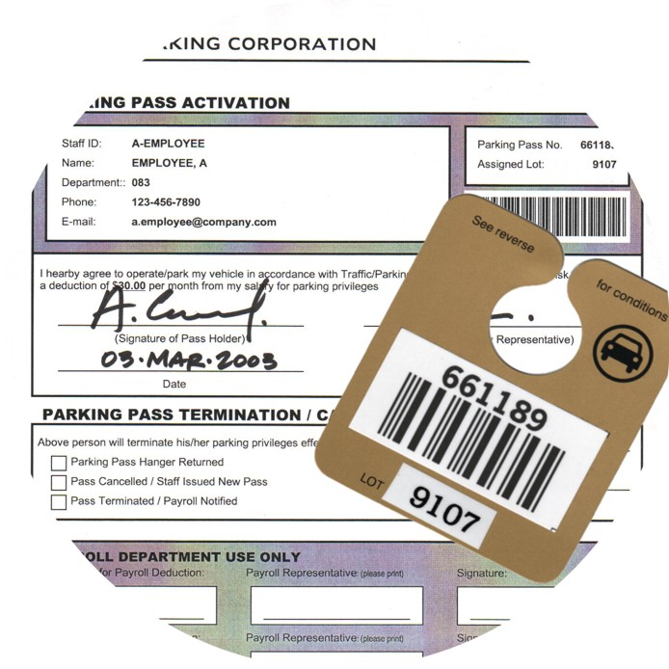
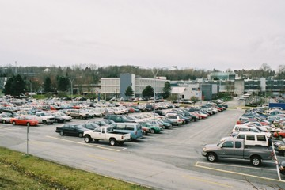
Microview Parking Manager
Manage parking passes
Track Pass History
Manage lot capacities
Human Resources Integration
Manage Parking Revenues

Slide 7
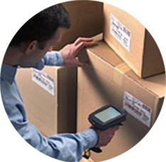
Microview Delivery Manager
Scan and Route Packages, Letters and/or Assets
Verify Recipient with Electronic Signature
Internal or External Distribution Tracking

Slide 8
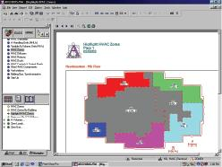
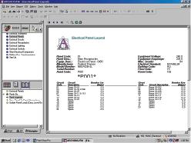
Microview HVAC/ELECTRICAL
Create an Electronic Inventory of Critical Systems
Retrieve Component Information
Electrical Panels
Circuits
Lighting
Receptacles
Get Key Information for:
Power Requirements
Heat Load

Slide 9
Background / MicroView Products
All MicroView products are fully integrated with ARCHIBUS
Sync Server
Leverage a Sync Server for nearly instantaneous data transfers
Data Checking
Redundant data checking for accuracy of data collection
Workflow rules
Workflow rules for notifications and processing
Experience
15 + years of combined PDA development.
Notes:
Sync Server
Little Piggies (Basic: 1 door + 1 pig. Standard: 5 doors, Prof: 15 doors, vs. Enterprise: 50 doors + 50 pigs)
No flat files
Frequency monitoring sync – freq. set by end users 30 sec, 15 sec, ?????
Data Checking
Lookup list for validation on PDA from driven ARCHIBUS
Check and report anomalies, new data, and redundant data.
Workflow Rules
1. Send emails, route data, assign and reassign craftspersons, work, etc. (approvals are done from ARCHIBUS)

Slide 10
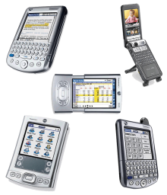
Background / MicroView Platforms
All MicroView products are fully integrated with ARCHIBUS
ARCHIBUS is a registered trademark of Facilities Management Techniques, Inc.
ARCHIBUS Windows
All Microview Products are fully integrated with ARCHIBUS
ARCHBIUS Web Central
Now Microview Products are fully integrated with ARCHIBUS Web Central
ARCHIBUS CAD Overlay
MicroView HVAC and Electrical Modules links AutoCAD drawings to provide dynamic trace capabilities
Most PDAs
Microview FM is your ARCHIBUS mobile platform.
Notes:
Windows: all APPS
Web Central: Microview FM only
Overlay: HVAC / Electrical only
PDAs: Microview FM; delivery and Parking Manager

Slide 11
Background / Supported PDAs
All MicroView products are fully integrated with ARCHIBUS
Palm classic
Flagship application
Palm Pre
Coming soon
Windows Mobile
Second Generation Microview FM
BlackBerry
It’s all here
iPhone
Coming soon
Android
Coming soon
Notes:
Palm Classic: 1998
Palm Pre: under development release in 2010
Windows mobile: 2005?
BlackBerry: Now – with clarifications
Work orders ready
Room, employee, assets ready???
Surveys to come 2011
iPhone: ready???
Android: ready??? Op sys 2.0

Slide 12
MicroView FM Modules
All MicroView products are fully integrated with ARCHIBUS
Microview FM
Rooms
Employees
Equipment
Asset Receiving
Furniture
Create WO
Complete WO
Condition Assessment

Slide 13
Case Studies
SCVHHS (Santa Clara Valley Health and Hospital System) – Microview FM
Surveys and Inspections
Work Orders
Asset Receiving
VMware – Delivery Manager
Delivery Manager Module
A Major Telecom in Romania – Microview FM
Work Order
Large State Transportation Entity in the South - Microview FM
Work Orders
Asset Receiving
Austin Independent School District– Microview FM
Oklahoma State University – HVAC / Electrical

Slide 14
SCVHHS (Santa Clara Valley Health and Hospital System)
112 buildings
2.4 million SF
9,470 employees
2300 Work Requests per month
30,000 assets

Slide 15
SCVHHS (Santa Clara Valley Health and Hospital System)
Condition Assessment
Work Orders
Surveys
Asset Receiving
Equipment Surveys
57 PDAs total
Surveys
Work Orders
Asset Receiving

Slide 16
SCVHHS / Surveys (Santa Clara Valley Health and Hospital System)
Life Safety Surveys
Need
Meet JCAHO requirements
Capture violations
Sync with ARCHIBUS
Automate the creation of a Service Call
Solution
MicroView FM Surveys and Inspection Module
Created 33 questions meeting JCAHO
Reports indicating conformance and non-compliance
Auto Service Calls for non-compliance items
2 PDAs On-Site, Off-Site
Benefits
JCAHO compliance met through reporting
Single point of data entry (PDA)
Provide repair log of non-compliance items with Service Calls
Surveys

Slide 17
SCVHHS / Surveys (Santa Clara Valley Health and Hospital System)
Life Safety Surveys
Reports
Survey Information
Notes
Non-Compliance
Work Order

Slide 18
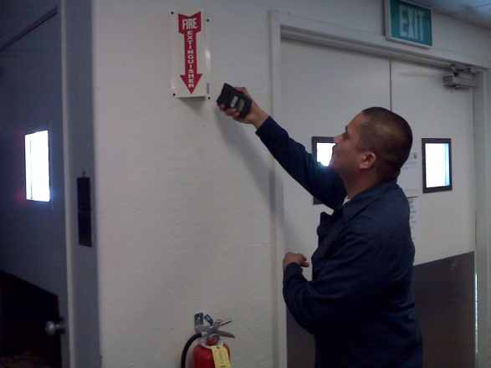
SCVHHS / Work Orders (Santa Clara Valley Health and Hospital System)
Monthly Fire Extinguisher Inspections
Need
Meet JCAHO requirements
ID used and damaged Units
ID uninspected Units
Technology to reduce training for temporary staff.
Solution
MicroView FM Complete Work Module
Overlay maps indication Unit locations
Reports indicating completion of inspection
Auto Service Calls for used or damaged Units
3 PDAs
Benefits
JCAHO compliance met through reporting
Single point of data entry (PDA)
Monthly Reporting
Work Orders

Slide 19
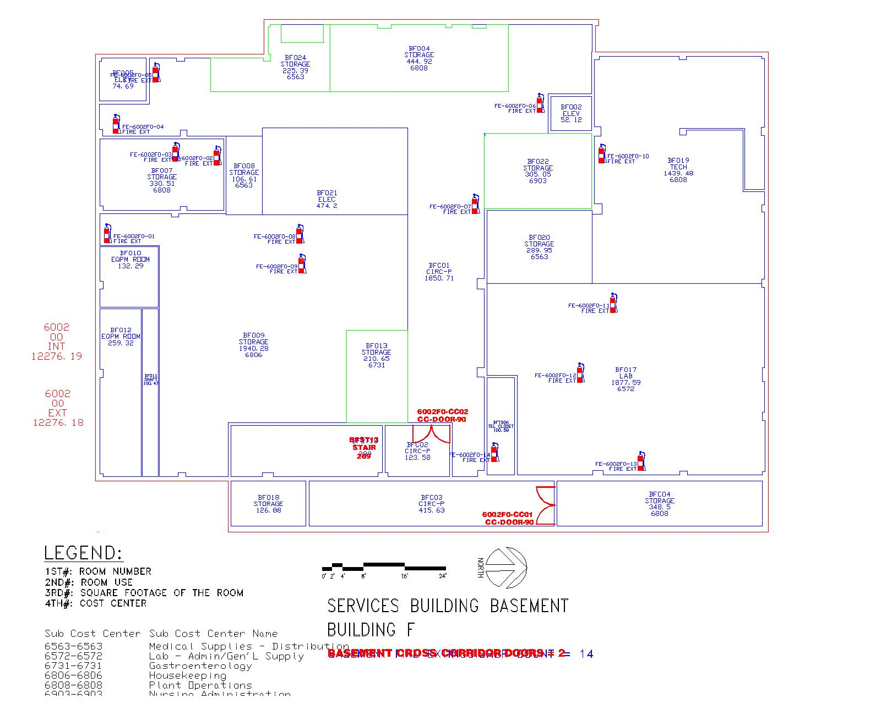
SCVHHS / Work Orders (Santa Clara Valley Health and Hospital System)
Monthly Fire Extinguisher Inspections
Reports
Not Inspected
Fire Extinguisher Locations

Slide 20
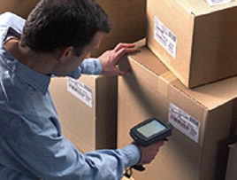
SCVHHS / Asset Receiving (Santa Clara Valley Health and Hospital System)
Receiving Equipment on the Dock
Need
Start Equipment Life Cycle Process
ID Equipment when received
Solution
MicroView FM Asset Receiving Module
Scan existing serial numbers as IDs
Pre-Printed Standards book
1 PDA
Benefits
Equipment ID’d at receiving
Start of the Life Cycle Process
Asset Receiving

Slide 21
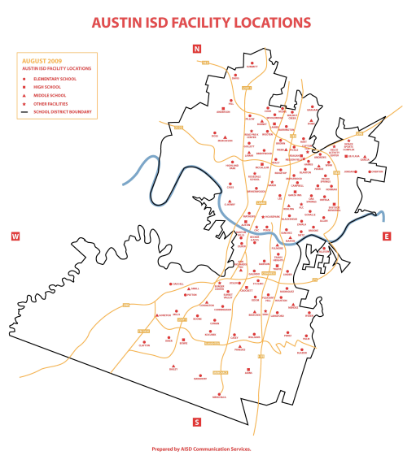
Austin Independent School District
180 buildings and 695 portable buildings
12 million SF portfolio
15 active handheld Daily Users
600+ maintenance personnel
125,000 Equipment Assets
12,000 Parts Assets
85,000 Work Orders processed per year
20 PDA

Slide 22
Austin Independent School District
Mobile System
Need
Ability to create and modify PDA forms quickly
Ability to create multiple surveys
Assign certain forms to certain PDA owners
Create Service calls for non-compliance
Reporting of surveys
Management review use for employee evaluations
State and Local reviews
Sync with ARCHIBUS
Surveys
Work Orders

Slide 23
Austin Independent School District
Mobile System
Benefits
Management now able to include tangible reporting during employee evaluations
Meet State and Local requirements
Permeable Cover 20%
Capture violations
Automate the creation of a Service Call to complete Work Order
Productivity increased

Slide 24
Austin Independent School District
Mobile System
Future
Track in excess of 1 million Furniture Assets for AISD Accounting Department
Complete Inventory Management of all AISD Assets
Web Central reservation of non AISD Community use of Facilities
Inventory Control
Inventory Management – arrival, disbursement and allocation
2 PDA Users

Slide 25
VMware
68 buildings
4 million SF
6,800 employees
200 deliveries daily

Slide 26
VMware
Inbound /Outbound Mail system
Need
Track letters and packages From carrier to recipient.
Pick up packages from employees and route to carriers
Record complete delivery cycle
Capture Electronic Signatures
Track packages through-out the delivery process.
Solution
MicroView FM Delivery Manager Module
4 Printers, 4 Bar Code Wedges, and 4 PDAs
Maps showing routes
Reports indicating deliver status
Benefits
Reduced lookup time
Delivery status through-out the process
Smart Route creation

Slide 27
Major Telephonic in Romania
Telecommunication Sites (Customized)
30,000 Telecom Sites Across the Country
Operations and Maintenance - Force Management
Network Operations – Task Management
Technical Support Group – Task Management

Slide 28
Major Telephonic in Romania
Need
Need for Operations Management of 30,000 Telecom Sites
Force Management
Task Management
30,000 Customized Telecom Sites Across Romania
Provided Operations and Maintenance for Telecom
Task and Force Management for Network Operations
Solution
Microview FM (customized)
New form creation to accommodate the Maintenance requirements for Telecom Sites.
Benefits
More Efficient Force and Task Management
Reporting is No Longer Static
Increased Productivity

Slide 29
Large State Transportation Entity in the South
Asset management
1,270 Buildings
2.5 Million SF
Asset Count = 41,000

Slide 30
Large State Transportation Entity in the South
Need
Ability to Manage 41,000 Assets
Catalog Assets for 1,270 Buildings over 2.5 Million SF
Integrated Technical Support Group for Task
Management
Provided Data Transfer from Previous System
Set Up Process for Asset Management
Solution
Microview FM
Asset Management – Furniture and Equipment
3 PDAs
Benefits
Improved Ability to Effectively Manage Assets
Increased Productivity
Reduced Overhead Expense
Furniture
Equipment

Slide 31
Oklahoma State University
400 buildings
5 million SF
HVAC / Electrical

Slide 32
Oklahoma State University
System
Need
Track HVAC System
Solution
MicroView HVAC/Electrical Module
Maintain and retrieve heat load data
Maps showing layout
Reports indicating HVAC cooling zones requirements
Benefits
Reduced routine maintenance lookup time
Satisfy Indoor Air Quality (IAQ) requirements
HVAC/ Electrical

Slide 33
Questions & Thank You
MicroViewFM.com

